Slide 1
PUNCH PUNCH
public punching pillow
Gabbie
Cylia
jiahua

Slide 2
Market and
looking for problems
Therapy Toy Market, belong to toy industry.
The global toy market is expected to exceed $90 billion in sales in 2016(ICTI)
Focusing on America therapy toy market.
Stress level go up about 44% compared with 5 years ago
Anger Management

Slide 3
Stress relief solution:
-physical expression:
exercise,hitting punching bag
-mental expression
listener, know your emotion
stimulate, cheer you up
a fun therapy toy
a punching pillow with
chatbot function
in your own private space
to release your anger and stess

Slide 4
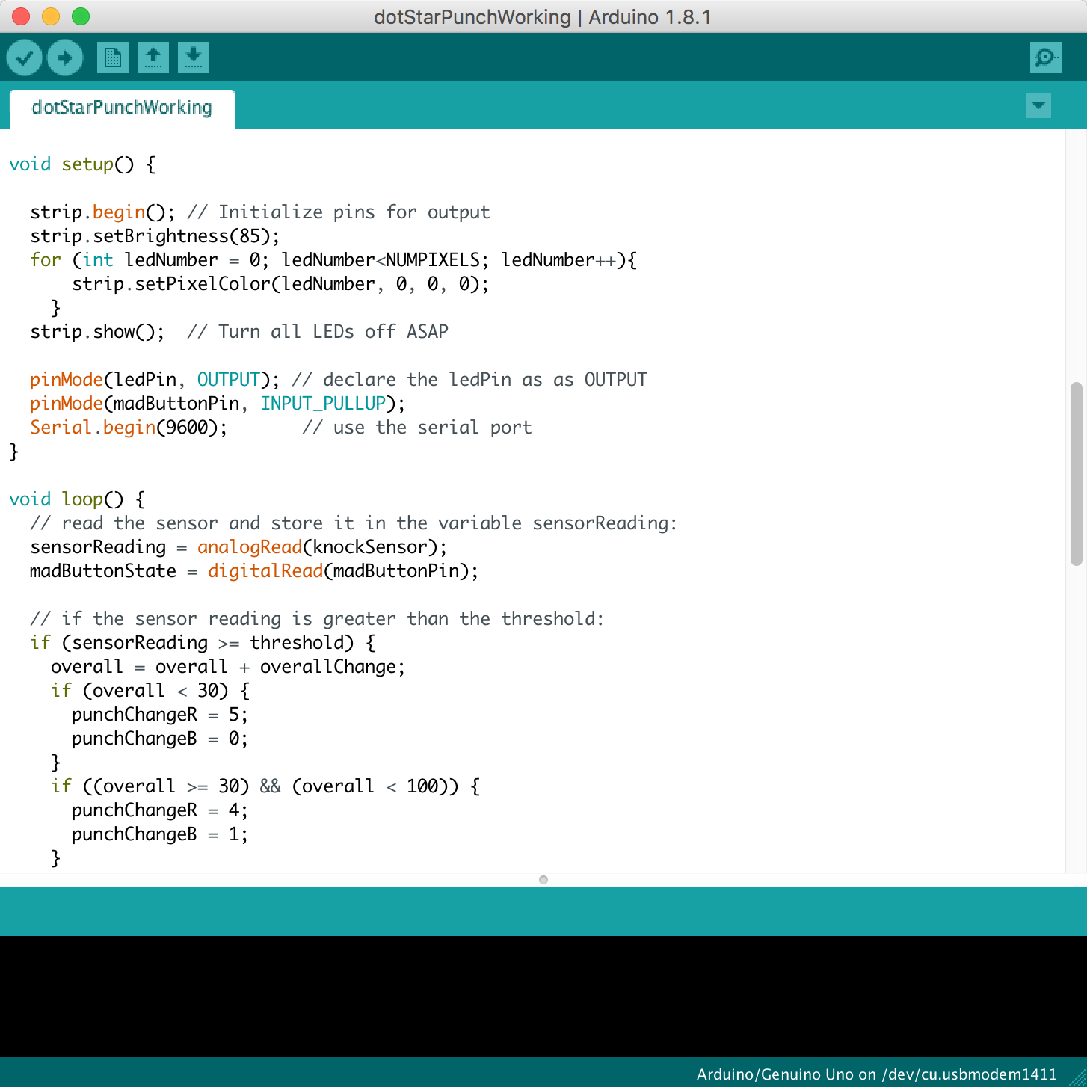
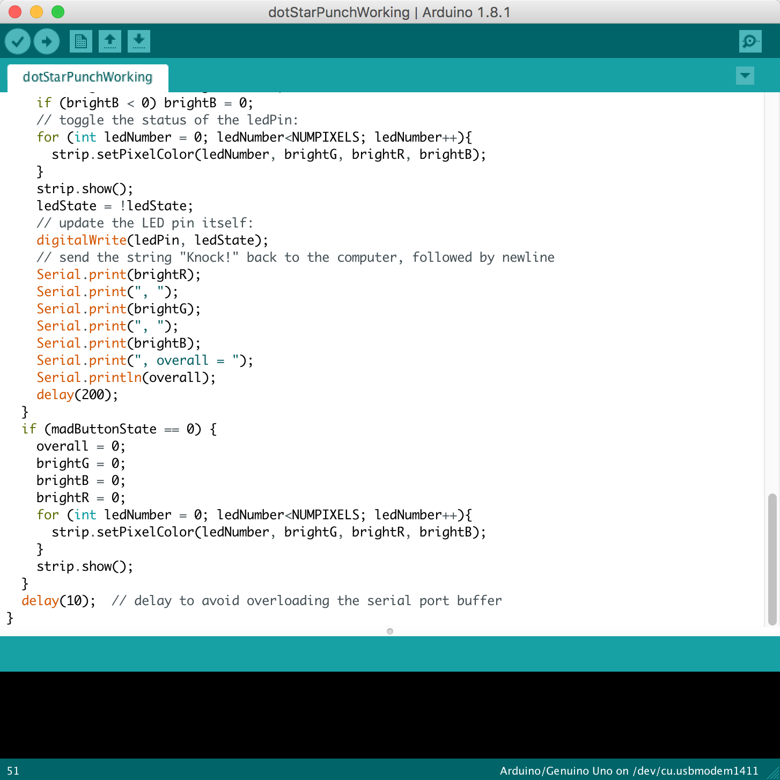
technology
Arduino
Piezo Disc or
Impact sensor
Megohm resistor

Slide 5
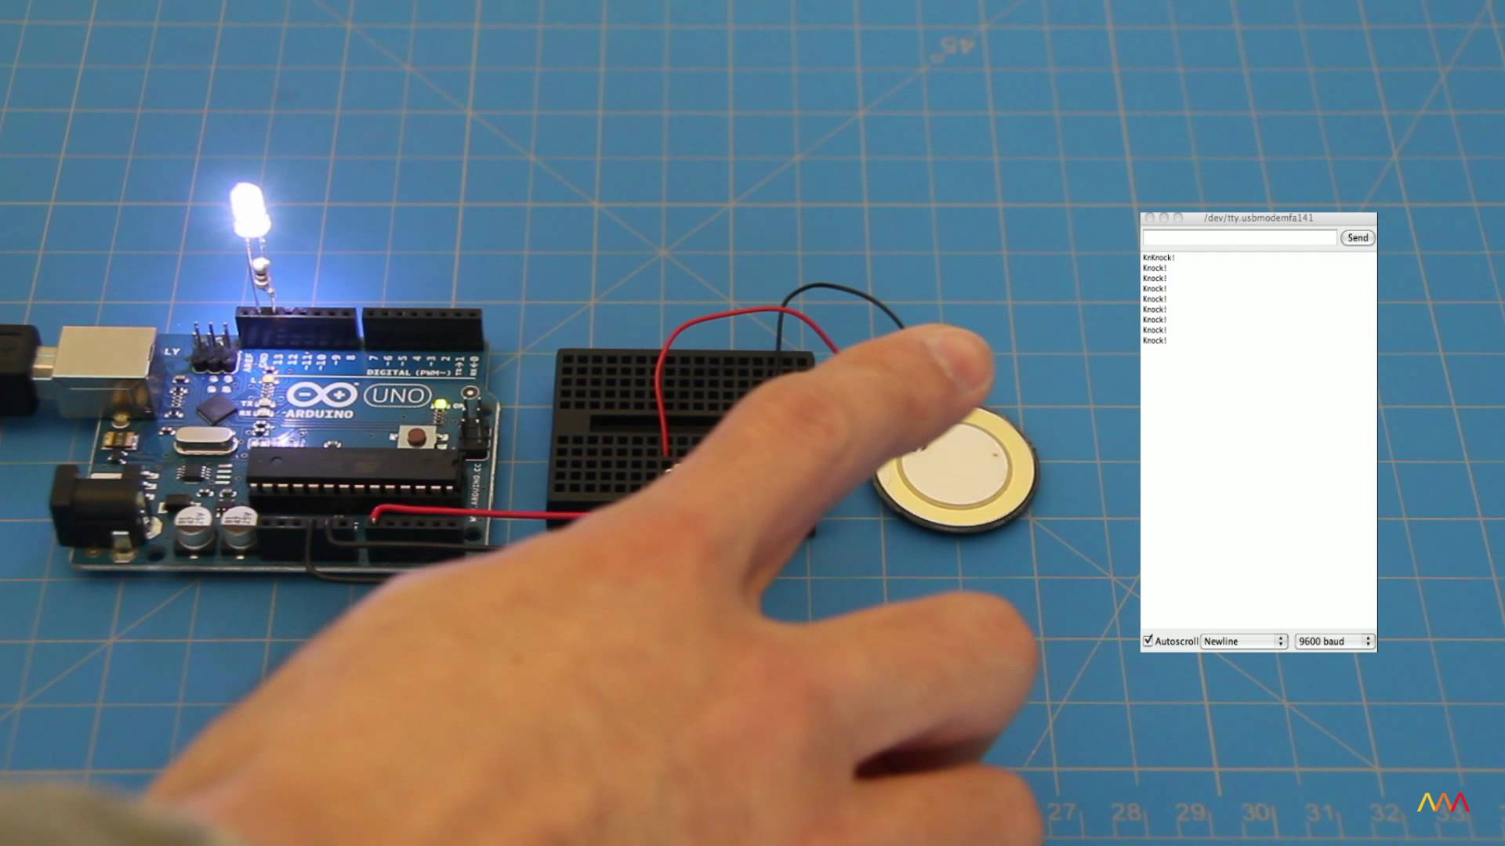

Slide 6
user testing
Can people really release their stress after punching?
Vilius
Not really reduce the stress; complex explanation about his mood - the word library in the code is not enough to judge his mood
Chen
Delightful, a fun thing to try out; the pillow is too soft and thin to punch, afraid of breaking it

Slide 7
goal changing
a fun therapy toy
a punching pillow with
chatbot function
in public space
to refresh yourself and temporarily blow away your anger and stress

Slide 8
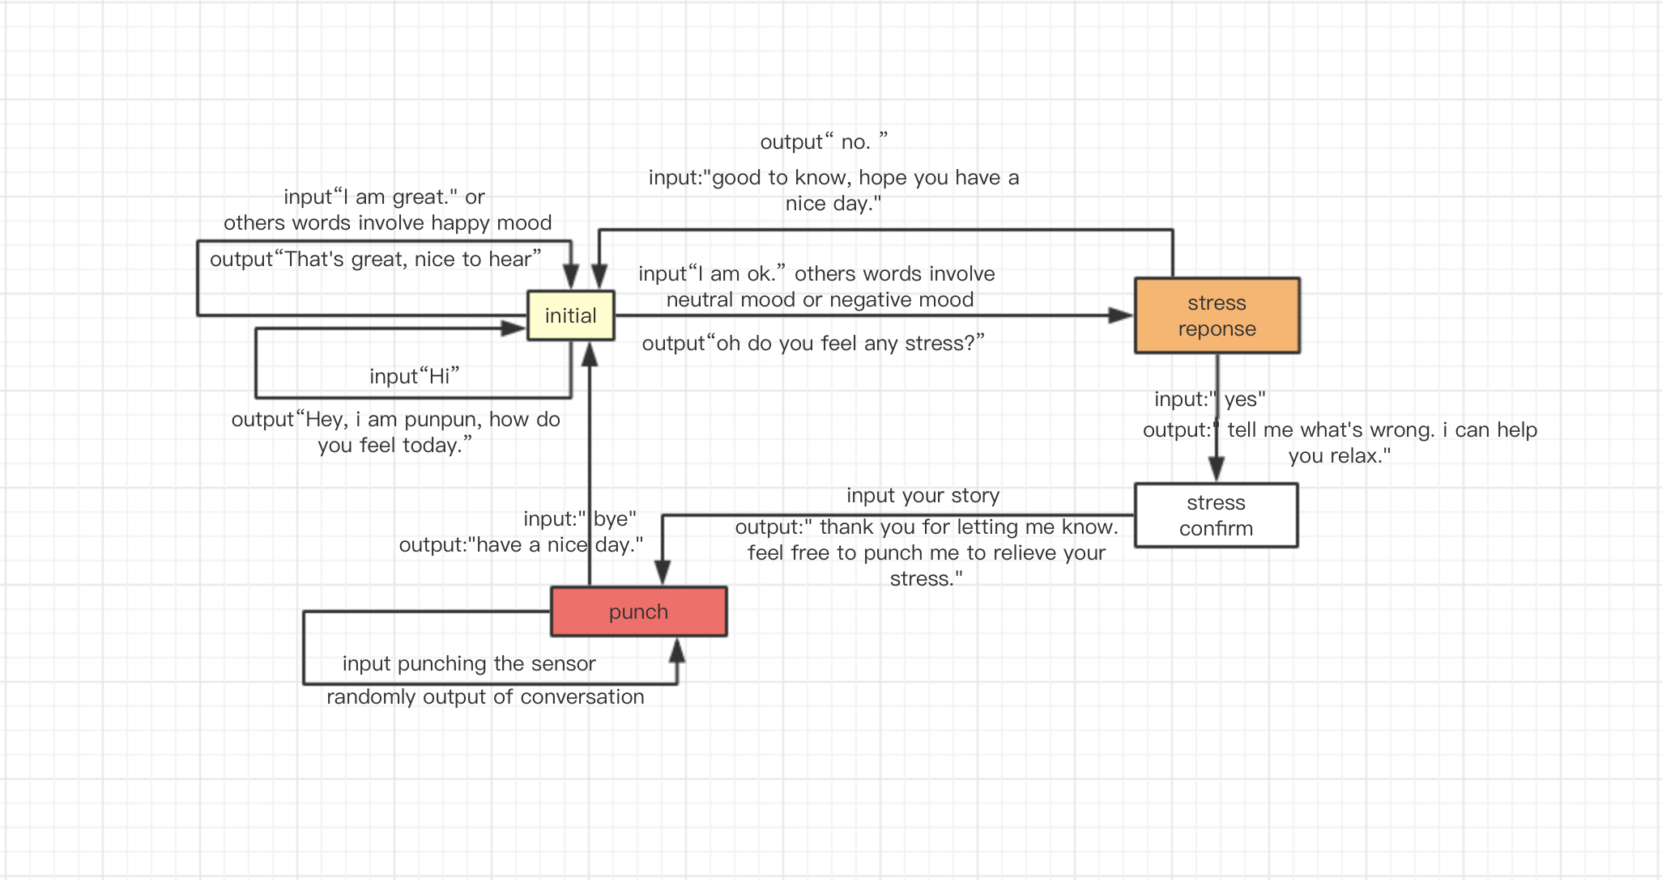
CONVERSATION DESIGN
experience process
-ask your feeling
-three emotional states: happy/neutral/negative (angry or sad)
-ask whether you have stress or not
-punching process

Slide 9
Let’s see how punpun works !

Slide 10
Thank you!

